Slide 1
Saturated Absorption Spectroscopy
Anthony Plechacek and Luzando Mukubu

Slide 2
Doppler Broadening

Slide 3
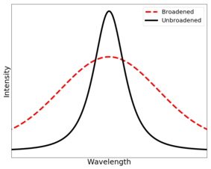
Doppler Broadening Effect on Data

Slide 4
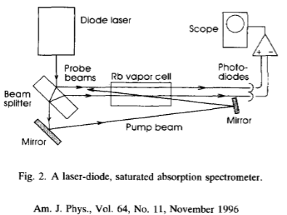
What is Saturated Absorption Spectroscopy?

Slide 5
Current Objectives
Measure Saturated Absorption Spectroscopy of Rhubidium
Tuning a diode laser
Medium Gain: through temperature
Internal Cavity: current and temperature
Grating Feedback: diffraction grating
External Cavity: piezoelectric motor
Setup Experiment
Collect Data

Slide 6

Questions

